Slide 1
ctcLink & Starfish Updates & timelines
Agenda
ctcLink
Unpacking ctcLink & Benefits
ctcLink Timeline
Three Things to Know
Preview of Faculty Self-Service
Preview of Student Self-Service
Starfish Update
Services for Students
Daniel Cordas – Project Director
Megan Court – Student Success Technology Specialist
Derreck Pressley – Campus Solutions Pillar Lead
Fall 2019

Slide 2
Unpacking ctclink
PeopleSoft
Made by Oracle, managed by SBCTC
Canvas LMS
Integrated with PeopleSoft
Campus Solutions (CS) Pillar
Student self-service, Faculty self-service, Registration, Financial Aid, Cashiering, etc
- Replaces SMS, FAM, and Degree Audit
HighPoint
Student self-service mobile interface
Finance (FIN) Pillar
Accounting, Purchasing, Grant Management etc
- Replaces FMS
25Live
Integrated for class room scheduling
Human Capital Management (HCM) Pillar
Employee self-service, HR, payroll
- Replaces PPMS
DirectLine MegaMations Facility management
“ctcLink” is the name of both SBCTC’s project and the name of how the system has been configured.

Slide 3
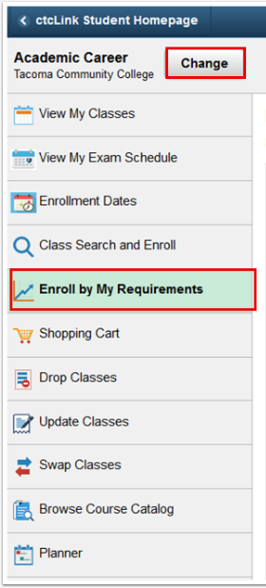
ctcLink Benefits
A set of common, mobile-friendly tools to handle most college business online, any time
A single ID and student record that follows students wherever they go within the Washington state community and technical college system
24/7 access to an online student center for registration, financial aid, tuition, contact instructors and advisors, view grades, track academic goals
Better tools for students to
plan their academic path (Student Planner)
see their alternatives (What-If scenarios in Planner)
enroll efficiently (Enroll by My Requirements)
Training screenshot from Campus Solutions 9.2

Slide 4
✓
Seattle Colleges
Seattle Colleges is well-positioned in Deployment Group 4 to learn from earlier deployments.
Deployment Group 2 implemented successfully in October.

Slide 5
High-Level Seattle Colleges Project Plan
Fall ‘19
Winter ‘20
Spring ‘20
Summer ‘20
Fall ‘20
Winter ‘21
Change Impact Analysis
Global PeopleSoft Design Courses
Business Process Fit/Gap Workshops
Local Configuration & Security Mapping
Online Training Courses
End User Training
User training for faculty, staff, and students
60+ online training courses
Setting up the system for Seattle Colleges
55 day-long workshops for finance, HR, and student services staff
27 SBCTC online courses for staff
65+ in-person sessions on PeopleSoft functionality
10/15/19 – 12/9/19
12/2/19 – 2/28/20
Go Live!
Feb. 1 2021
7/1/19 –
2/28/20
Data Cleanup
Data Conversion and Validation
students, transcripts, courses
employees, jobs, and pay
Final Cutover

Slide 6
Three Things you Need to know
1. We have begun our ctcLink implementation as part of Deployment Group 4 and have a scheduled launch date of February 1, 2021
2. Clark College successfully launched ctcLink, as did the SBCTC agency, with the updated PeopleSoft 9.2 in late October
3. Our project activities have begun
Change impact analysis sessions
Online learning to prepare for Business Process Fit/Gap Sessions
Signing staff up to attend the BPFG sessions – Beginning in December!

Slide 7
Faculty self-service

Slide 8
View my Schedule
Accessed through the Faculty Center
Will display your teaching schedule for the current term
Can view other terms as desired, provided the class schedule exists
Can toggle between viewing all classes or just those with registered students
Can display weekly schedule in calendar view

Slide 9
View my Schedule cont’d

Slide 10
View my Schedule cont’d

Slide 11
View Class roster
Includes basic academic information including:
Academic Program/Plan
Grade Basis
Number of registered credits
Name
ID
Photo (if available)
Enrollment status for the course (enroll, dropped, waitlisted, etc..)
Ability to send notifications to one, some, or all students on the roster
Ability to download class roster to excel

Slide 12
View Class roster cont’d

Slide 13
View Class roster cont’d

Slide 14
Grade roster
Can determine if entering mid-term or final grades
Can view 20 students at a time or all at once
Can grade students in batches or one at a time
System requires last date of attendance for non-passing grades
Approval Status
Not Reviewed – status prior to adding grades
Ready to Review – status after you have entered grades for all students; can still change grades at this point
Approved – final grades are submitted and posted to students; no grade change options available from this page

Slide 15
Grade roster cont’d

Slide 16
Grade roster cont’d

Slide 17
Student Self-Service

Slide 19
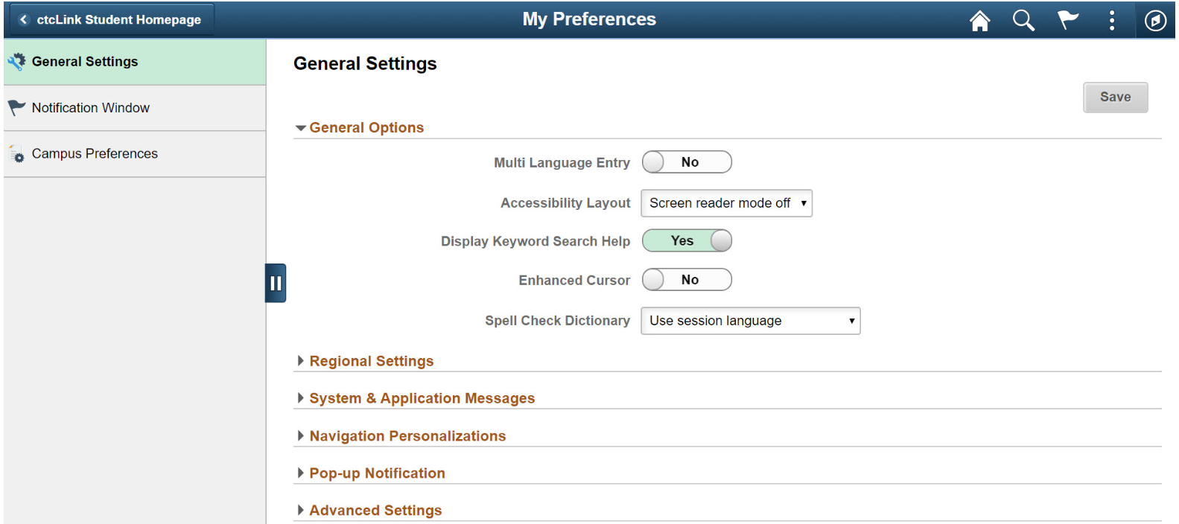
Student self-service menu
The student can set their own user preferences including:
Language & currency preferences
Accessibility preferences
Campus Preferences
Navigation & email preferences

Slide 20
Student self-service menu cont’d
Students can also:
Update Student Bio/Demo Information
Register for classes
Pay bills
Update privacy restrictions

Slide 21
Tasks and Holds

Slide 22
To do list

Slide 23
Holds

Slide 24
Manage Classes

Slide 25
Search and Enroll in classes

Slide 26
Search and Enroll in classes cont’d
Additional ways to search:
Keyword search
Subject
Class status
Course career
Credits
Location
Instruction mode
Class meeting days, times, attributes, and components (lec, lab, etc…)

Slide 27
Search and Enroll in classes cont’d

Slide 28
Search and Enroll in classes cont’d

Slide 30
Enroll by my requirements

Slide 33
planner
The Planner allows students to plan future courses based on unfulfilled
degree requirements on the AAR or selections from the course catalog.

Slide 34
Academic progress summary
Notes:
Pie chart comes from AAR, shows requirements completed and remaining, student can detail into Academic Progress to see specific requirements and courses.
Can refresh to show recently added transfer credit.

Slide 35
Academic progress

Slide 36
What-if reports
What-if reports are used to simulate a change in a student’s academic plan.
It can show a student or their advisor how an AA Nursing’s student completed, transferred, and registered course work would apply to the requirements for a general AA DTA.
Does not recognize milestones, but does recognize subplans

Slide 37
Starfish Project Background
2018 Requirements & Selection Committee
Erin Barzen  Jesse Knappenberger  Greg Dempsey  Joyce Allen  Laura Hopkins  Yoshiko Harden  Kim Struiksma  Kathleen Weber  Kate Krieg  Kayoko Mathews  William Spence  Naina Eshwar  Kevin Bowersox-Johnson  Melody McMillan  Alive Melling, Stephanie Dykes  Joe Barrientos  Linnea Hengst  Bob Scribner  Daihong Chen  Wendy Schneider  Victor Kuo  Cindy Riche  Barb Childs
Co-Chairs: Kurt Buttleman  Rosie Rimando-Chareunsap
Student Success Technology Platform
Tools for Student Services like advising, financial aid, tutoring
Online and walk-in appointment scheduling with kiosks and integration with Office365 calendars
To-Dos and Success Plans to guide students' next steps
Reporting and Analytical tools to support student services
Connects students to faculty and staff in a Success Network
Connecting each student to a specific advisor by area of study or special population
Provides easy messaging of groups of students
New ways to support students
Provides Career discernment help through Starfish Careers
Early Alert tools to help connect students to resources & services

Slide 38
Key Benefits
for Students
Easily ask for help
Quickly discover which support services are available, where they are, and how best to reach out to them.
Schedule appointments online to meet with an advisor, tutor, instructor, financial aid counselor… or any of the other people put in place to help them succeed.
Receive notifications and reminders the way they prefer, on the device they prefer.
Learn the next steps to take to proceed in their academic path or to resolve a concern. Check in on their own progress as often as needed.
Become inspired by the encouraging messages from the people who recognize their hard work.
for Staff
Quickly provide feedback on students and help connect them with services
Access useful information on your students on one screen
Easily share your concerns with the right people at the right time
Understand predicted retention and how to address risk
Provide positive reinforcement of successful behaviors
Communicate with students individually or in groups
Easily record outcomes on student meetings

Slide 39
Starfish Student Experience

Slide 40
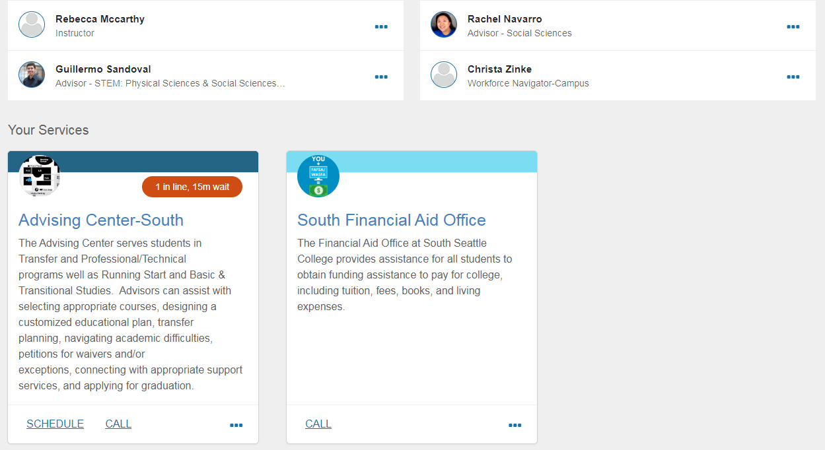
Starfish Student Interface – South Example

Slide 41
Starfish:
Phases 1 & 2
_____________________
Since May
20399 appointments
5142 made by students
45 active services
10+ services starting W20
Phase 1
Advising Offices
Academic Advising
BAS Advising
TRiO Support Services
Running Start
College Transfer
Career Center (Central)
Completion Coaching (South)
Enrolled Students
(using MySeattleColleges)
Phase 2 (in progress)
Faculty
Early Alert Design & Pilot (in progress)
Student Services
Financial Aid
Support Programs
Tutoring (South now, Central W20)
Secondary Advising
The WORKS (Force/Source/First)
MESA
Counseling
Electronics Program Advising
Admitted-not-Enrolled Students
EADs created upon admission

Slide 42
Early Alert Design & Pilot Process
Recruit Faculty
Volunteers from each college
Beginning recruiting in May
21 faculty confirmed – 80% FTF
Open invite sent in May
Configuration Workshop
2 day workshop, September 2019
Learning & configuring Early Alert
Faculty & Student Services
Held Sept. 3 & 4, 40 participants
Pilot Design with Kudos, Referrals, and Notifications
Early Alert Pilot
(in progress)
Fall 2019
Same faculty join Early Alert pilot
Learn
18 faculty in pilot now
Bi-weekly faculty check-ins
Student feedback with IR
Winter 2020
Improve based on student and faculty feedback
Expand Referral and Notification options
Full Launch
Spring 2020
All Faculty

Slide 43
Early Alert Pilot Design
Kudos are a way for faculty and staff to provide positive feedback to a student.
Kudos
Your hard work is paying off! Keep it up!
Thank you for reaching out.
You’re building community.
You’re developing good learning strategies.
You found your voice.

Slide 44
Early Alert Pilot Design
Referrals allow a faculty member to connect a student with a specific office or staff person.
Referrals
Financial Aid & Funding Referral
Advising Referral
Basic Needs Referral

Slide 45
Early Alert Pilot Design
Notifications intend to notify a student or staff person that an action is needed.
Notifications
Referral Needed
(Notification directly between a faculty member and a student’s primary advisor to provide a way for faculty to get direction or assistance when they are not sure if there is an applicable on-campus resource or are not sure how to address a concern. It is not seen by the student.)
Student has a Registration Block
(Automated notification will show to faculty, students, and the assigned primary advisor.)
Student Not Registered for Next Quarter
(Automated notification that will show to faculty, students, and the assigned primary advisor within Starfish.)

Slide 46
Thank you!

